Slide 1
Sales Data Analysis using Excel
STUDENT NAME: BALAJI R
REGISTER NO: 4C4E686EF37CE25AC6A4AA682EFACAB4 (asunm1319122201507)
DEPARTMENT: B COM CORPORATE SECRETARYSHIP COLLEGE: PACHAIAPPA’S MENS COLLEGE, CHENNAI-30

Slide 2
ANALYSIS TITLE
Sales Analysis Praveen Fast Foods using Excel

Slide 3


AGENDA
1.Problem Statement 2.Project Overview 3.End Users
4.Our Solution and Proposition 5.Dataset Description 6.Modelling Approach 7.Results and Discussion 8.Conclusion
3/21/2024 Annual Review

Slide 4

PROBLEM STATEMENT
DUE TO HEAVY SALES THEY ARE UNABLE TO TRACK
WHICH MANAGER DID MOST SALE ?
WHICH MODE OF TRANSCTION HAPPENED THE MOST ?
WHICH FOOD TIME HAD MOST NUMBER OF SALES ?
BY WHICHFOOD CATEGORY THEY EARNED MORE ?
HOW MUCH REVENUE GENERATED ?

Slide 5

ANALYSIS OVERVIEW
THERE IS BRIEF ANLAYSIS OF HOW SALES HAPPENIG
,BY WHOM IT’S BEEN HAPPING,WHICH TIME,MODE OF TRANSACTION,FOOD PRODUCT AND HOW IT’S BEING REGULATED AND THEIR MOST GENERAL POSTION ON IT.

Slide 6

WHO ARE THE END USERS?
THE END USERS ARE ABSOULTLEY THE BUSINESS OWNER , HENCE THE DATA HERE GENERATED IS RELATED TO THE FINANCIAL POSTION AND THE MONETRY STATUS OF THE BUSINESS AND THEIR ANALYSIS TOO.

Slide 7

OUR SOLUTION AND ITS VALUE PROPOSITION
WE HAD REVIWED THEIR DATA INCH BY INCH.
PERCISELY ORDED THEM INTO THE FORMAT.
CLEARLY ANALYSIED THEM.
ORDERED THEM IN A PRORPER MANNER WITH ALONG ANS AMONGST DESCRIPTIONS.
VALUED THEIR THE POSTION AND THEIR STATUS IN THEIR BUSINESS.
FUULY ANLAYSIED THEIR GIVEN DATA AND VISUALIZING IN A PRESENTABLE MANNER.

Slide 8
Dataset Description
ORDER ID
DATE
ITEM NAME
ITEM TYPE
PRICE
QUANTITY
AMOUNT
TRANSACTION BY
MANAGER
TIME OF SALES

Slide 9

THE "WOW" IN OUR SOLUTION
WE USED ,
TABLE
SUMMARIZED THEM.
USED PIVOT TABLE FOR VALUES.
GRAPHS LIKE PIECHART,LINE AND BAR.
3/21/2024 Annual Review
9

Slide 10
MODELLING
1. DATA MINNING :
THERE IS SO MANY DATA TO WE CAN SCROLL ON SO FIRST GO THROUGH AND GRASP THE CONTENT IT TO FURTHER PROCESS.
2 . FINDING DUPLICATE :
IT IS THE MOST PRIMARY AND NECESSARY PROCESS FOR VALIDATION.
3 . FILTERATION :
WE ALTERDED AND FILTERED DATA FOR PRECISNESS AND ACCURACY.
10

Slide 11
DATA CORRECTION :
A MAIN FUNCTION FOR AN ACCURATE RESULT IN ANAYSIS.
DATA TUBULATION :
TABLED THEM IN AN ORDER FOR EASY ACCESS AND FOR VISUVALIZATION.
VALUATION :
VALED THEIR QUANTITY AND AMOUNT TO FIND IT’S TOTAL,MINIMUM AND MAXIMUM

Slide 12
PIVOT TABLE :
USED PIVOT TABLE FOR SORTATON FOR ANALYSATION OF DATA.
GRAPHS :
USED GRAPH FOR PICTORIAL REPRESENTATION OF DATA FOR CLEAR AND DETAILED ANYSIS.
MANAGING ALL :
MANAGED AND REPLACED IN ORDER TO VIEW AND TO GRASP THE CONTENT EASLIY.

Slide 13
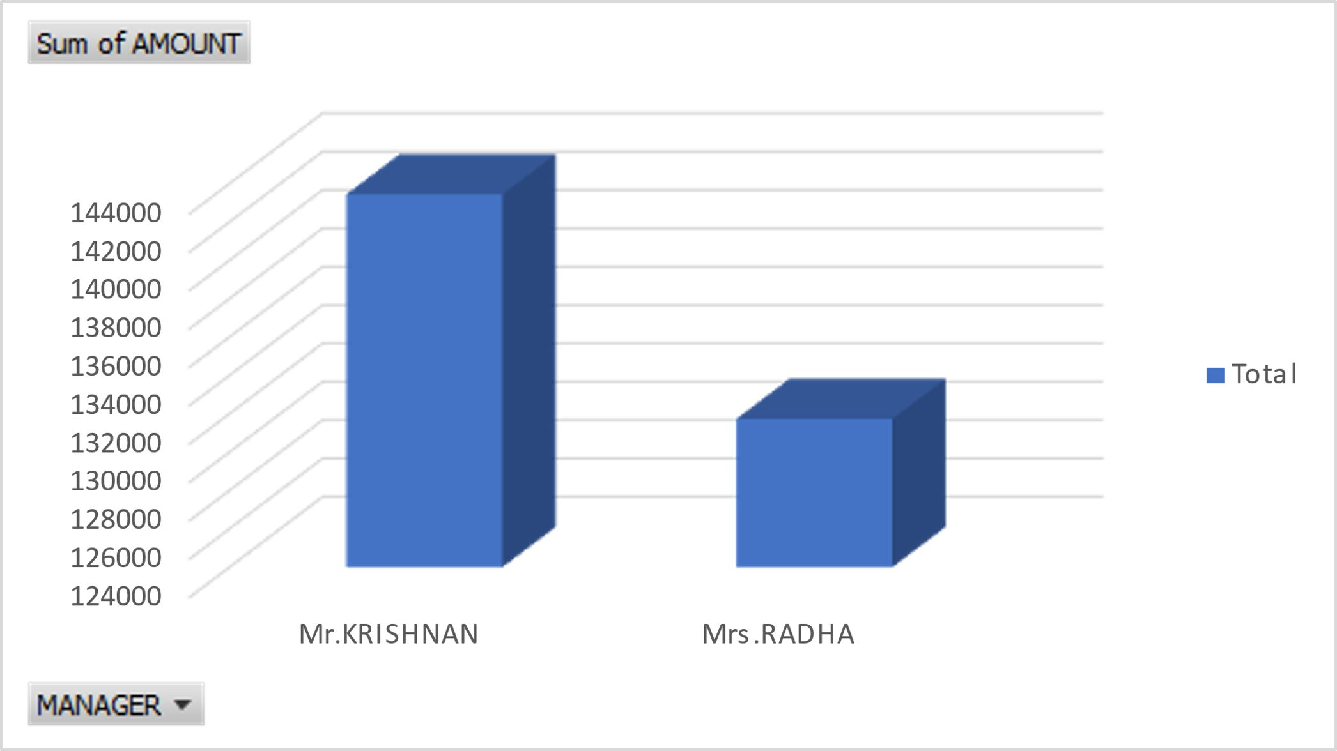
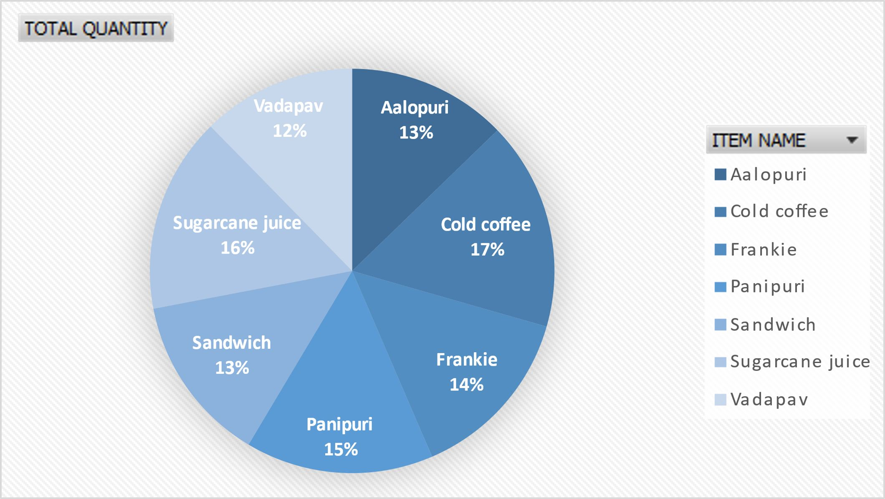
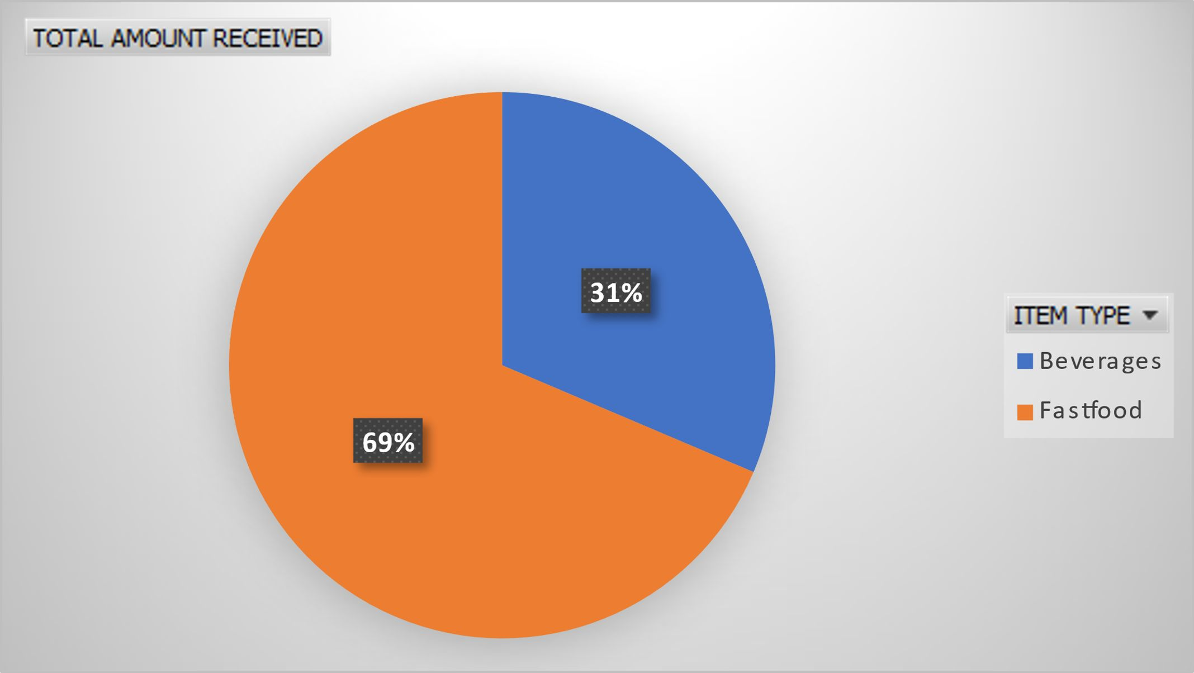
RESULTS
13

Slide 14
conclusion
MANAGERS | Sum of AMOUNT
Mr.KRISHNAN Mrs.RADHA |  | 143440 131730
Grand Total ITEMS | TOTAL QUANTITY | 275170
Aalopuri 1041 Cold coffee 1361 Frankie 1150 Panipuri 1226 Sandwich 1097 Sugarcane juice 1278 Vadapav 1006
Grand Total 8159
ITEM TYPE TOTAL AMOUNT RECEIVED
Beverages 86390 Fastfood 188780
Grand Total 275170

